Slide 1
Quantum Theory

Slide 2
Objective:
Objective:
describe the Bohr and quantum models, describe the s, p, d, f orbitals

Slide 3
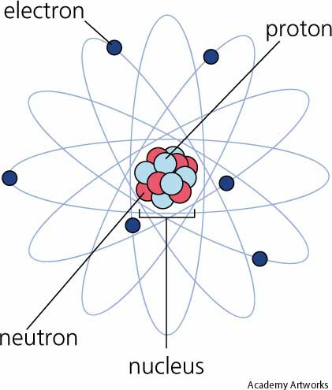
Review: Do Not Write Rutherford’s Nuclear Model (Planetary Model)
Rutherford: positive mass was in nucleus and electrons were outside
Could not explain chemical behavior of elements or electron location

Slide 4
Bohr Model
Niels Bohr looked at H, proposed its 1 e⁻ moved in circular path around nucleus

Slide 5
Bohr Model
Each orbit has specific energy: called energy level
Farther from nucleus = higher energy level
Quantum: packet of energy
Must lose or gain quantum to move energy levels

Slide 6
Now you try…
Tell you partner how the electrons moved according to the Bohr model. Draw a diagram in your notes.

Slide 7
Quantum Mechanical Model
Based on probability
Cannot know exact location of e⁻, only most likely locations
Electron cloud:
e⁻ cloud is more dense closer to nucleus because e⁻ attracted to p⁺
●

Slide 8
Quantum Mechanical Model
Schrodinger’s equation: in each energy level there is a probability of finding an e⁻ in a specific location
Called atomic orbitals

Slide 9
Now you try…
Tell your partner where the most likely place to find an electron is according to the quantum mechanical model.

Slide 10
Atomic Orbitals
Energy levels have different orbitals (shapes) where you can find e⁻
Orbitals denoted by letters

Slide 11
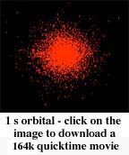
Atomic Orbitals
s = spherical, 1 shape

Slide 12
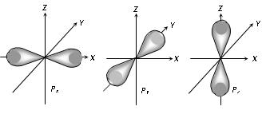
Atomic Orbitals
p = peanut or dumbbell shape, 3 shapes

Slide 13
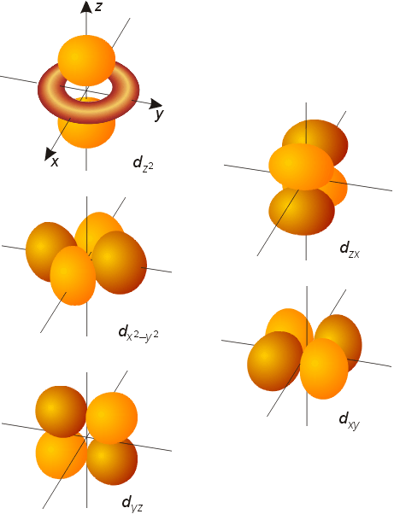
Atomic Orbitals
d – 5 shapes

Slide 14
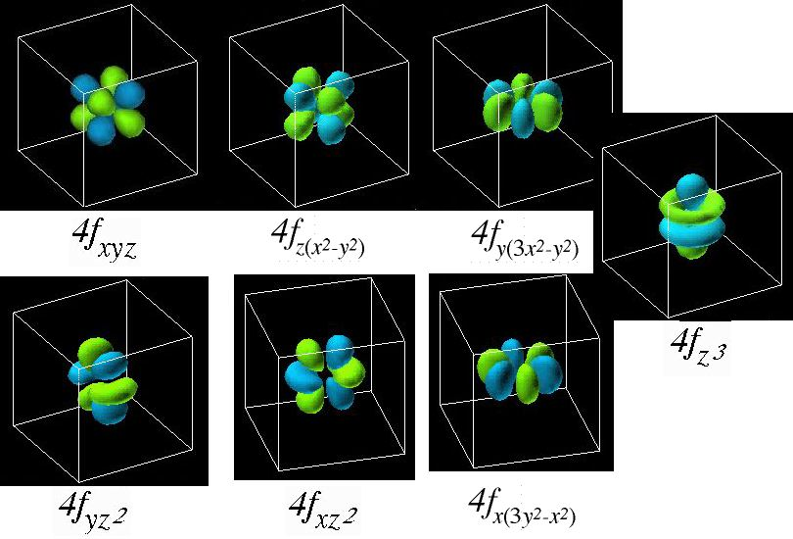
Atomic Orbitals
f : 7 shapes

Slide 15
Now you try…
Tell your partner how many shapes an s, p, d, and f orbital have.

Slide 16
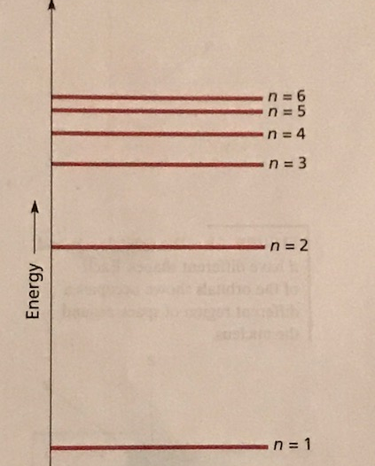
Principal Quantum Number
Quantum mechanical model designates Bohr’s energy level as the principal quantum number.
The principal quantum number (n), indicates the main energy level occupied by electron.
As n increases, the electron’s energy and its average distance from the nucleus increases.

Slide 17
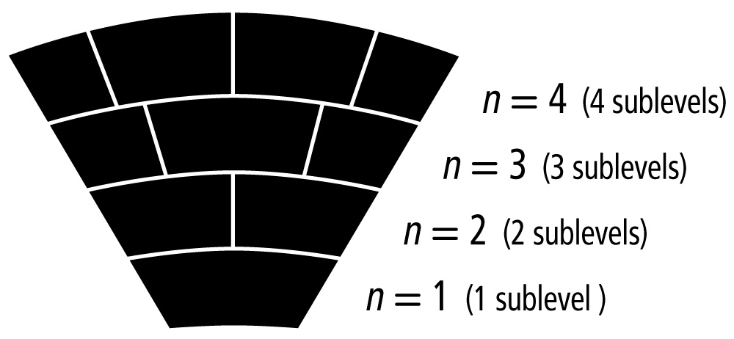
Energy Sub Levels
Principal energy levels are broken up into sublevels
The number of sub- levels is equal to the Principal energy level
Recall there are at least 4 possible types of sublevels—given labels: s, p, d, or f
Recall s, p, d, and f are the shapes of the possible orbitals
Notes:
Quantum number (a.k.a. Principal Quantum # is the actual Energy Level)

Slide 18
Atomic Orbitals
Quantum number: n
# of sublevels: n
# of orbitals: n²
# of electrons in orbitals: 2n²
Notes:
The first shell only has the s subshell – 2 electrons
The second shell has the s and p subshells 2 + 6 = 8 electrons
The third shell has the s, p and d subshells; 3rd shell – 2 + 6 + 10 = 18 electrons
The fourth shell has the s, p, d and f subshells; 4th shell – 2 + 6 + 10 + 14 = 32 electrons
The fifth shell has the s, p, d, f and g subshells; 5th shell – 2 + 6 + 10 + 14 + 18 = 50 electrons
The sixth shell has the s, p, d, f, g and h subshells; 6th shell – 2 + 6 + 10 + 14 + 18 + 22 = 72 electrons

Slide 19
Atomic Orbitals
Principle quantum # 1: 1s
Principle quantum # 2 : 2s, 2p
Principle quantum # 3 : 3s, 3p, 3d
Principle quantum # 4 : 4s, 4p, 4d, 4f

Slide 20
Now you try…
Look at the diagram of “hotel electron”. Can you find any relationships between the number of orbitals (doors) and the energy level? How about the energy level and the number of shapes available? Discuss with your neighbor.

Slide 21
Ticket Out the Door
1) If you are looking at quantum number 6:
A) how many sublevels will you have?
B) how many orbitals will you have?
C) how many electrons will you have?
Hint: use the formulas we just discussed in your notes
2) Where is the most likely place to find an electron?
3) What are the 4 atomic orbitals and how many shapes are associated with each one?

