Slide 1
Periodic Table and Electron Configurations

Slide 2
Objective
Objective: describe the relationship between electron configurations and an elements location on the periodic table

Slide 3
Periodic Table and Electron Configurations
Element’s period corresponds to # of energy levels that e⁻ can be found in
Group A elements show a wide variety of properties due to s and p orbitals

Slide 4
Periodic Table and Electron Configurations
Group 1: always ends in s¹
Ex:
  Li: 1s²2s¹ (Li: period 2)
  Na: 1s²2s²2p⁶3s¹ (Na: period 3)
  K: 1s²2s²2p⁶3s²3p⁶4s¹ (K: period 4)

Slide 5
Periodic Table and Electron Configurations
Group 2: always ends in s²
Ex:
  Be: 1s²2s² (Be: period 2)
  Mg: 1s²2s²2p⁶3s² (Mg: period 3)

Slide 6
Periodic Table and Electron Configurations
Group 13: p¹
Group 14: p²
Group 15: p³
Group 16: p⁴
Group 17: p⁵

Slide 7
Periodic Table and Electron Configurations
Group 18: full s and p orbital (except He, it only has 2 e⁻ so its full shell includes only 1s)
  Makes them unreactive
s orbital e⁻ + p orbital e⁻ = # valence e⁻

Slide 8
Transition Metals
Transition metals: all e⁻ config end in d
Inner transition metals: all e⁻ config. end in f

Slide 9
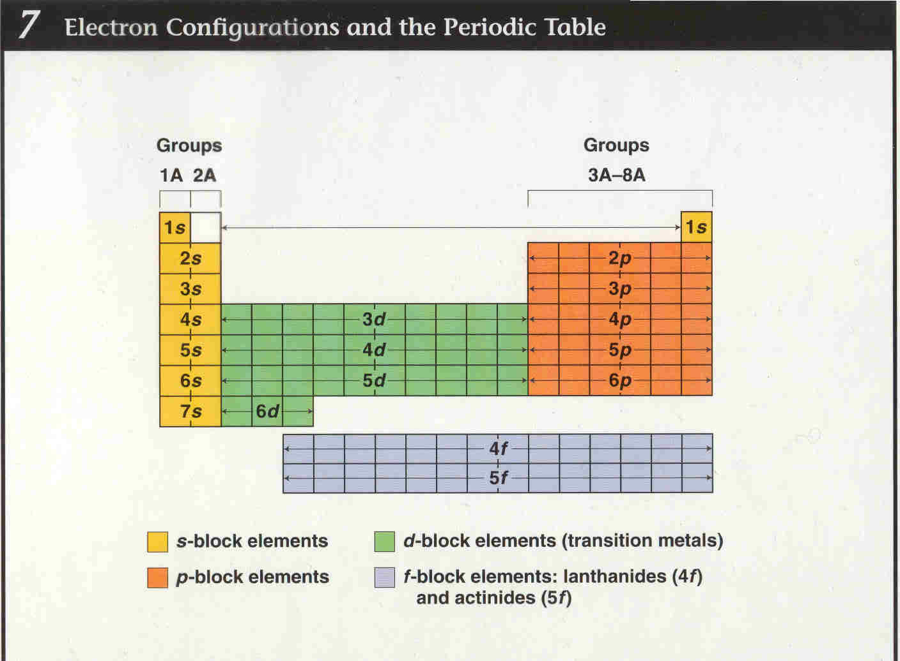
Notes:
Show electron configuration using the periodic table You Tube video

Slide 10
Now you try…
Using your periodic table and board, write down what the ending electron configuration for each element will be according to its location on the periodic table
A) Ba
B) I
C) Cs

Slide 11
Ticket Out the Door – Review Questions
1) What electron configuration do all elements in group 1 end with? Group 17?
2) What is the trend for electron configurations when looking at the transition metals?
3) What is the trend for electron configurations when looking at the inner transition metals (lanthanide and actinide series)?

