Slide 1
“Crash Course” in Lab Safety
Oops.

Slide 2
Number one rule for lab safety:
Don’t Be Stupid. Use common sense. ☺
Listen to and follow all teacher instructions
Don’t be a rogue scientist (no unauthorized experiments)
Never work alone
Don’t mess around

Slide 3
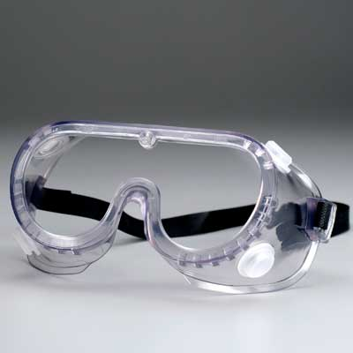
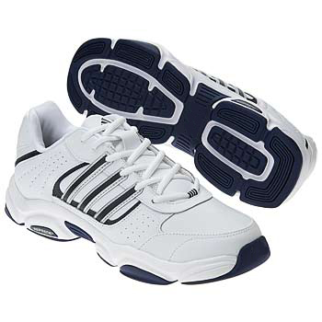
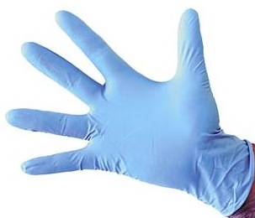
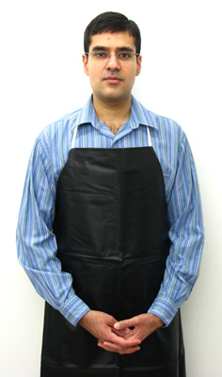
Personal Protective Equipment
Goggles
Glasses are not adequate
Closed-toed shoes
Bring a pair to leave in the room
Gloves
If needed
Apron
BYO

Slide 4
First Aid Kit
See me before using

Slide 5
Safety Shower
Use if you have spilled large quantities of chemicals all over yourself
Pull metal handle to activate

Slide 6
Eye Wash
Use to flush chemicals or contaminants from eyes
Flush for 15 minutes

Slide 7
Fire Blanket
Use to extinguish yourself or your friend (or frenemy)
Wrap in blanket and lay on floor (to avoid becoming a chimney)

Slide 8
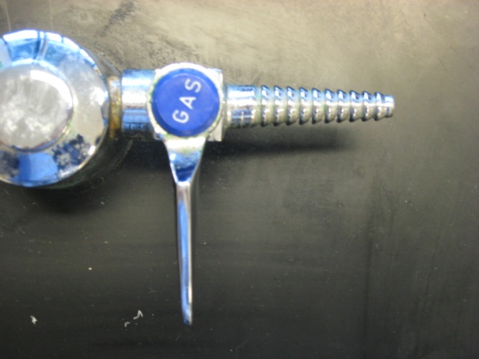
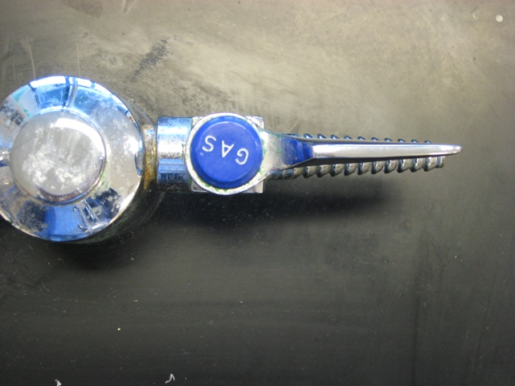
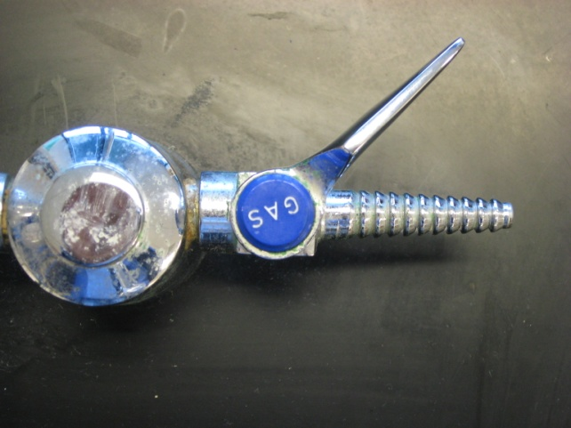
Bunsen Burners
Keep hands, clothing, hair, etc. away from the flame
Which gas valve is open?

Slide 9
Fire Extinguisher
Pull pin
Squeeze handle
Point at base of fire
Sweep back and forth

Slide 10
Fire (Real or Drill)
Turn off gas valves and electrical equipment
Exit promptly but safely
Turn RIGHT outside classroom; exit to the LEFT in the Upper Quad C Commons Area; rendezvous at football field
If real fire, pull fire alarm on the way out

Slide 11
Gas Shut-Off Valve
Only open if instructed

Slide 12
Fume Hood
Uses negative pressure (suction) to remove vapors
Off-limits to you (unless otherwise instructed)

Slide 13
Broken Glass Container
Alert me right away of broken glass (penalties if you DO NOT tell me right away)
I will clean it up with broom and dustpan (do not use fingers)
No broken glass goes in the trash – ever!

Slide 14
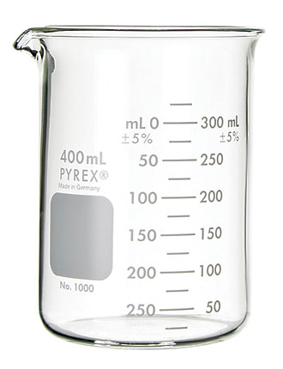
Handling Glassware
Hot glass and cool glass looks the same!
Same goes for metals!
Allow glass to cool entirely before handling it
Or, use rubber grippers to handle warm glass

Slide 15
How to Smell in Lab
Don’t wear deodorant
Waft!
Don’t taste, touch, or smell chemicals unless instructed to do so

Slide 16
What NOT to Do
Have or consume food or drink (including gum) in the laboratory area
Wear loose or baggy clothing, jewelry, or long hair
Dispose of chemicals improperly (follow all instructions)
Enter the prep room without permission
Add or remove any chemical from the lab area
Point the open end of a heated test tube at anyone (including yourself)

Slide 17
What to do!
Be safe ☺
Report all accidents immediately, no matter how minor
Keep the lab stations clear (backpacks under your desk) and don’t stand in “travel lanes”
Ask if you are unsure of a procedure before trying it

Slide 18
AEDs
Just in case, you should know the location of our Automatic External Defibrillators…
Outside the main gym in the Wildcat (closest)
Outside the main office in the cafeteria
Outside the concession stand at the football field

