Slide 1
Metallic Bonding

Slide 2
Objective
Objective: describe how metallic bonds form and how this is related to the properties of metals

Slide 3
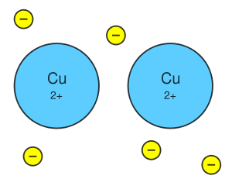
Metals
Metals are composed of closely packed cations where valence e⁻ drift and float between cations

Slide 4
Metals
Metallic bond: created by attraction of free floating e⁻ to positive metal cations
“sea of e⁻” float freely between cations

Slide 5
Properties of Metals
Good conductors of electricity: due to e⁻ able to move freely
Ductile: can be drawn into wire,
e⁻ can move in any direction so they fill in gaps between cations
Malleable: can be flattened into a sheet
Free e⁻ allow metals to be easily shaped

Slide 6
Alloys
Most metals we use are alloys
Alloy: mixture of 2 or more elements where at least 1 element is a metal
Alloys typically have more useful properties than pure metals
Example: stronger, resistance to rusting and corrosion

Slide 7
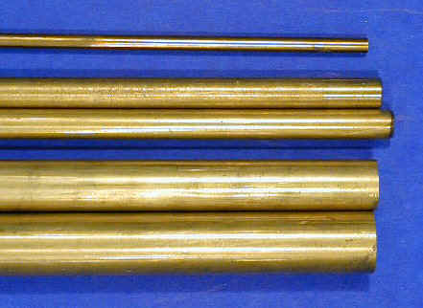
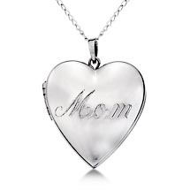
Common Alloys
Brass
Brass: made of copper and zinc
Sterling silver: 92.5% silver, 7.5% copper
Sterling Silver

Slide 8
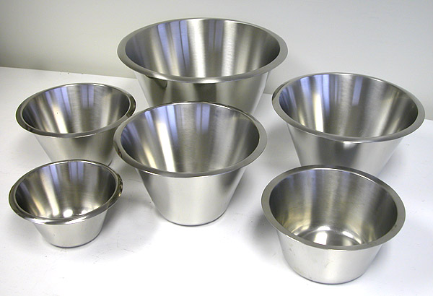
Common Alloys
Bronze
Bronze: 7 parts copper, 1 part tin
Steel: most important alloy
Fe can be mixed with C, B, Cr, Mn, Mo, Ni, W, V depending on the type of steel
Steel

Slide 9
Ticket Out the Door – Review Questions
1) Explain in 2-3 sentences how the “sea of electrons” helps hold a metallic bond together.
2) Explain in 2-3 sentences how the sea of electrons allows a metal to be malleable and ductile

