Slide 1
Electron Configurations

Slide 2
Objective
Objective: use the Aufbau principle, Hund’s rule, and the Pauli exclusion principle to write electron configurations

Slide 3
Atomic Orbitals
Electrons arrange in s, p, d, f orbitals to make stable atoms
The arrangement of the electrons in their orbitals is called e⁻ configuration
Aufbau principle: e⁻ occupy lowest energy levels first
always start with s orbital, then p, d, and f
Cross over starts in 3rd and 4th level

Slide 4
Atomic Orbitals
Aufbau principle: e⁻ occupy lowest energy levels first
always start with s orbital, then p, d, and f
Cross over starts in 3rd and 4th level
Pauli exclusion principle: full orbital contains 2 e⁻
One e⁻ spins clockwise (↑), other spins counterclockwise (↓)
Full orbital: ↑↓
Hund’s rule: all e⁻ will be unpaired before they pair up

Slide 5
Now you try…
Tell your partner what the Aufbau principle, Pauli exclusion principle, and Hund’s rule are in your own words.

Slide 6
Writing Electron Configurations
using Orbital Notation
s²
s holds a maximum of 2 electrons
s _____

Slide 7
Orbital Configurations
p holds a maximum of 6 electrons
p⁶
p _____ _____ _____

Slide 8
Orbital Configurations
p holds a maximum of 6 electrons
p³
p _____ _____ _____

Slide 9
Orbital Configurations
p holds a maximum of 6 electrons
p⁵
p _____ _____ _____

Slide 10
Orbital Configurations
d holds a maximum of 10 electrons
d¹⁰
d _____ _____ _____ _____ _____

Slide 11
Orbital Configurations
d holds a maximum of 10 electrons
d⁶
d _____ _____ _____ _____ _____

Slide 12
Orbital Configurations
f holds a maximum of 14 electrons
f¹⁴
f ____ ____ ____ ____ ____ ____ ____

Slide 13
8s
7s 7p
6s 6p 6d
5s 5p 5d 5f
4s 4p 4d 4f
3s 3p 3d
2s 2p
1s
Electron Configurations

Slide 14
1s
8s
7s 7p
6s 6p 6d
5s 5p 5d 5f
4s 4p 4d 4f
3s 3p 3d
2s 2p
1s
2s
2p
3s
3p
4s
3d
4p
5s
4d
5p
6s
4f
5d
6p
7s
6d
7p
8s
5f

Slide 15
1s 2s 2p 3s 3p 4s 3d 4p 5s 4d 5p 6s 4f 5d 6p 7s 5f 6d 7p 8s
8s
7s 7p
6s 6p 6d
5s 5p 5d 5f
4s 4p 4d 4f
3s 3p 3d
2s 2p
1s

Slide 16
8s
7s 7p
6s 6p 6d
5s 5p 5d 5f
4s 4p 4d 4f
3s 3p 3d
2s 2p
1s
Follow the arrows to create an electron configuration.
Each arrow represents a step.

Slide 17
8s
7s 7p
6s 6p 6d
5s 5p 5d 5f
4s 4p 4d 4f
3s 3p 3d
2s 2p
1s
Sample electron configuration Problems:
The first arrow passes through 1s. An s orbital only has one level, so the first arrow gives 2 electrons and 2 elements. Each new electron means a new element.
Hydrogen =1 electron 1s¹
Helium = 2 electrons 1s²

Slide 18
8s
7s 7p
6s 6p 6d
5s 5p 5d 5f
4s 4p 4d 4f
3s 3p 3d
2s 2p
1s
The second arrow passes through 2s. An s orbital only has one level, so the second arrow adds 2 electrons and 2 elements. Each new electron means a new element.
Lithium = 3 electrons = 1s² 2s¹
Beryllium = 4 electrons = 1s² 2s²

Slide 19
The third arrow passes through 2p and 3s. A p orbital has 3 level, and an s orbital has 1 level so the third arrow adds 8 electrons and 8 elements. Each new electron means a new element.
8s
7s 7p
6s 6p 6d
5s 5p 5d 5f
4s 4p 4d 4f
3s 3p 3d
2s 2p
1s
Boron = 5 electrons 1s² 2s² 2p¹
Magnesium =1s² 2s² 2p⁶ 3s² (12 total electrons)

Slide 20
The fourth arrow passes through 3p and 4s. A p orbital has 3 level, and an s orbital has 1 level so the fourth arrow adds 8 electrons and 8 elements. Each new electron means a new element.
8s
7s 7p
6s 6p 6d
5s 5p 5d 5f
4s 4p 4d 4f
3s 3p 3d
2s 2p
1s
Aluminum: 1s²2s²2p⁶3s²3p¹
Calcium 1s² 2s² 2p⁶ 3s² 3p⁶ 4s²

Slide 21
Give the electron configuration for C, N, F, Na.
Carbon = 6 electrons 1s² 2s² 2p²
Nitrogen = 7 electrons 1s² 2s² 2p³
Fluorine = 9 electrons 1s² 2s² 2p⁵
Sodium = 11 electrons 1s² 2s² 2p⁶ 3s¹

Slide 22
Give the electron configuration for Fe, Zn, Br, Sr.
Iron = 26 electrons 1s² 2s² 2p⁶ 3s² 3p⁶ 4s² 3d⁶
Zinc= 30 electrons 1s² 2s² 2p⁶ 3s² 3p⁶ 4s² 3d¹⁰
Bromine = 35 electron 1s² 2s² 2p⁶ 3s² 3p⁶ 4s² 3d¹⁰ 4p⁵
Strontium= 38 electrons 1s² 2s² 2p⁶ 3s² 3p⁶ 4s² 3d¹⁰ 4p⁶5s²

Slide 23
Now you try….
Write the electron configuration for
Cobalt
What element is this?
1s² 2s² 2p⁶ 3s² 3p⁵

Slide 24
1s 2s 2p 3s 3p 4s 3d 4p 5s 4d 5p 6s 4f 5d 6p 7s 5f 6d 7p 8s
8s
7s 7p
6s 6p 6d
5s 5p 5d 5f
4s 4p 4d 4f
3s 3p 3d
2s 2p
1s

Slide 25
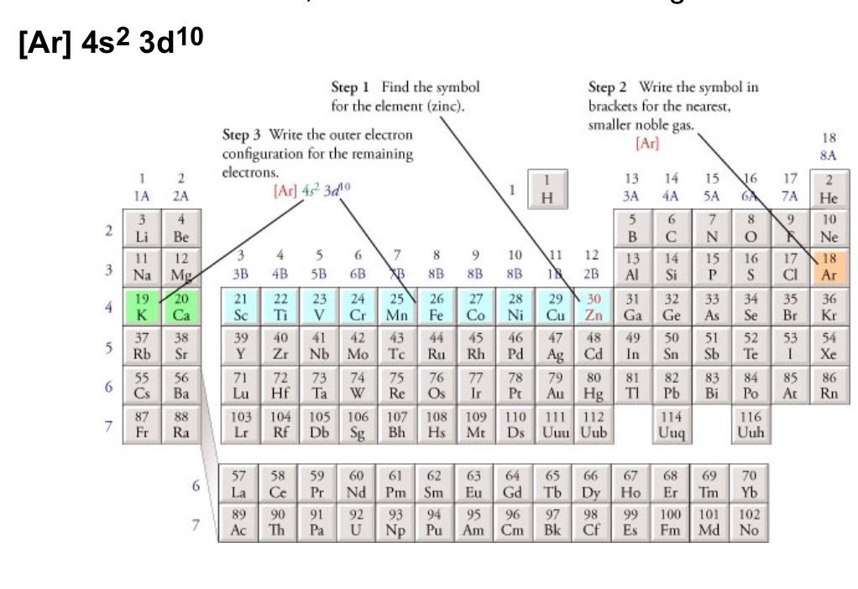
Abbreviated
Find the symbol for the element on the periodic table
Write the symbol in brackets for the noble gas located at the far right of the preceding horizontal row on the table
Move back down a row and to the far left. Following the elements in the row write the outer –electron configuration associated with each column until you reach the element you are describing.

Slide 26
Ticket Out the Door
1) Write the electron configuration and arrow fill diagram for P.
2) What element is this?
1s² 2s² 2p⁶ 3s² 3p⁶ 4s² 3d¹⁰ 4p⁶5s²

