Slide 1
Acids & Bases
They are everywhere..
In your food
In your house
EVEN IN YOU!!!!!

Slide 2
What is an acid?
An acid is a solution that has H⁺ ions.
An acid is any substance that creates Hydrogen Ions (H⁺) in water.
The more H⁺ ions, the more acidic the solution.
Examples of acids: HCl (H⁺ and Cl⁻), HNO₃ (H⁺ and NO₃⁻)

Slide 3
Examples of Acids
Hydrochloric Acid – HCl
Nitric Acid – HNO₃
Sulfuric Acid – H₂SO₄
What do you notice about the first letter of each?
What does this tell you about the molecule?

Slide 4
Properties of an Acid
pH ‹ 7
Tastes Sour
Corrosive
Reacts with metals and carbonates
Turns blue litmus paper red
Picture from BBC Revision Bites http://www.bbc.co.uk/schools/ks3bitesize/science/chemistry/acids_bases_1.shtml

Slide 5
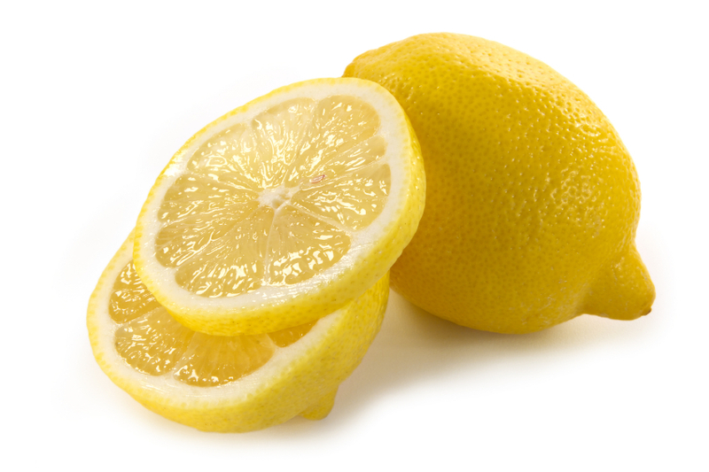
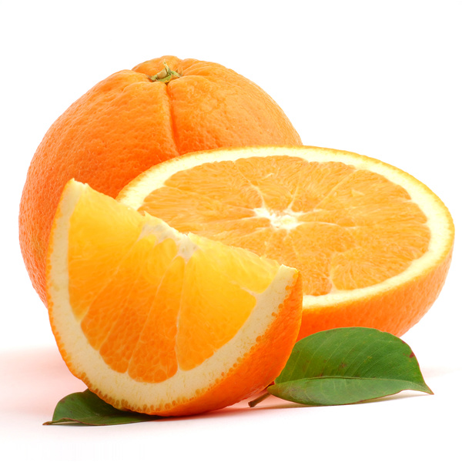
Properties of Acids
Sour Taste
Items such as citrus fruits are acidic in nature
They contain citric acid which gives them their sour taste

Slide 6
Properties of Acids
Acids react with metals
Acids will “eat away” at metals such as magnesium zinc, and iron.
This property is described as being corrosive
Acids react with carbonates
Carbonate ions (CO₃²⁻) have a negative charge and when acids react with them Carbon Dioxide gas is produced
An example would be the reaction of Hydrochloric Acid (HCl) with Limestone

Slide 7
Uses of Acids
Acids are used in a variety of ways every day:
Many of the foods we eat contain acids
Acids are often used in cleaning supplies
Acids in your stomach allow you to digest food
Lactic acid in your muscles causes fatigue
Acids are used in lawn care products

Slide 8
Some Common Acids
Vinegar
Citrus fruits (lemons, limes, & oranges
Ascorbic acid = Vitamin C which your body needs to function.
Car batteries

Slide 9
What is a base?
A base is a solution that has OH- ions.
A base is any substance that produces Hydroxide Ions (OH⁻) in water
Another word for base is alkali.
Examples of Bases: NaOH (Na⁺ and OH⁻), Ca(OH)₂ (Ca⁺² and OH⁻)

Slide 10
Examples of Bases
Sodium Hydroxide – NaOH
Potassium Hydroxide – KOH
Calcium Hydroxide – Ca(OH)₂
Magnesium Hydroxide -- Mg(OH)₂
What do you notice about the ending of each base?
What does this tell you about each molecule?

Slide 11
Properties of a Base
pH › 7
Feel Slippery
Taste Bitter
Does not react with metals or carbonates
Strong Bases are corrosive
Turns red litmus paper blue.

Slide 12
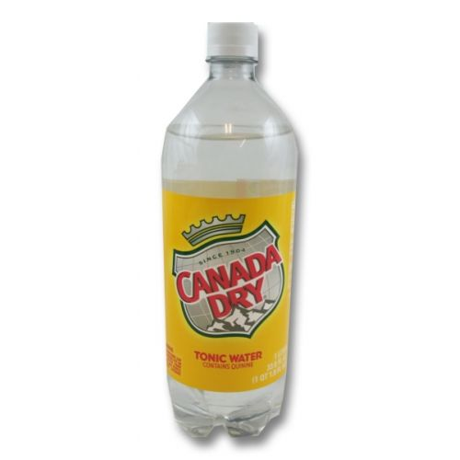
Properties of Bases
Bases have a bitter taste
Tonic water is a drink that has a bitter taste due to the base quinine.

Slide 13
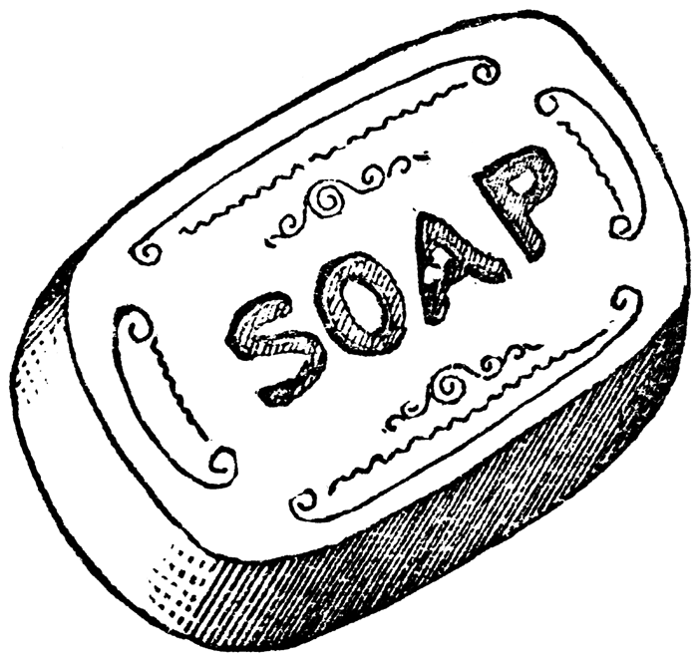
Properties of Bases
Bases have a slippery feel
Items such as soap and shampoo are bases

Slide 14
Uses of Bases
Bases are also useful to us everyday:
Baking soda reacts with acids in baking to create the carbon dioxide gas that causes bread to rise
Milk of Magnesia and Calcium Carbonate are used to neutralize stomach acids
Many cleaning supplies have bases in them
Bases are used to help make mortar and cement

Slide 15
Uses of Bases
Used in soaps, ammonia, and other cleaning products
The OH- ions interact strongly with certain substances, such as dirt and grease.
Chalk
Blood is a basic solution.

Slide 16
Measuring the Strength of Acids and Bases
To measure the strength of acids and bases we use the pH scale which ranges from 0 – 14.
The pH scale measure the concentration of hydrogen ions (H⁺) in a solution
When pH is low, the concentration of hydrogen ions is high.
The lower the pH the stronger the Acid
The higher the pH the stronger the base
A pH of 7 is considered neutral

Slide 17
pH Scale
A change of 1 pH unit represents a tenfold change in the acidity of the solution.
For example, if one solution has a pH of 1 and a second solution has a pH of 2, the first solution is not twice as acidic as the second—it is ten times more acidic.

Slide 18
pH Scale
Acidic solutions have pH values below 7
A solution with a pH of 7 is neutral.
Pure water has a pH of 7.
Basic solutions have pH values above 7.

Slide 19
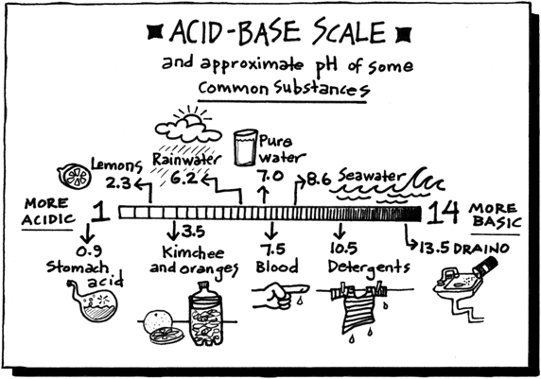
The pH scale…

Slide 20
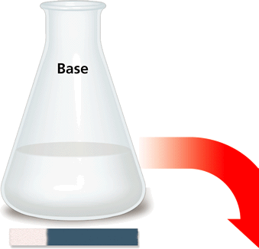
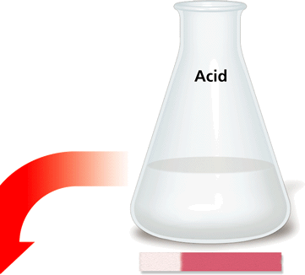
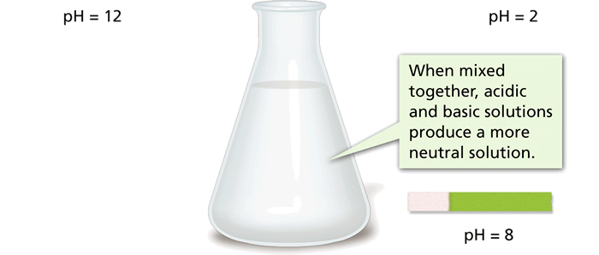
What happens when Acids and bases React with each other?
A reaction between an acid and a base is called neutralization.
An acid-base mixture is not as acidic or basic as the individual starting solutions.
Although it is called a neutralization reaction, the resulting solution is not always neutral (pH of 7). It depends on the strength of the acid and the base that are combined.
The result of a “perfect” neutralization reaction is a solution with a pH of 7

Slide 21
Acid – Base reactions
HCl + NaOH → NaCl + H₂O
The products of an acid base reaction are a salt and water
Water comes from the combination of the hydrogen ions and the hydroxide ions
This is a type of double replacement reaction

Slide 22
Acid Nomenclature
HCl
HNO₃
H₂SO₄
⇒ hydrochloric acid
⇒ nitric acid
⇒ sulfuric acid

Slide 23
Acid Nomenclature
No Oxygen
In acid
w/Oxygen
An easy way to remember which goes with which…
“You ATE something ICky, and you bITE something deliciOUS”

Slide 24
Name ‘Em!
HI
HBr
H₂SO₃
H₂CO₃
H₃PO₄

Slide 25
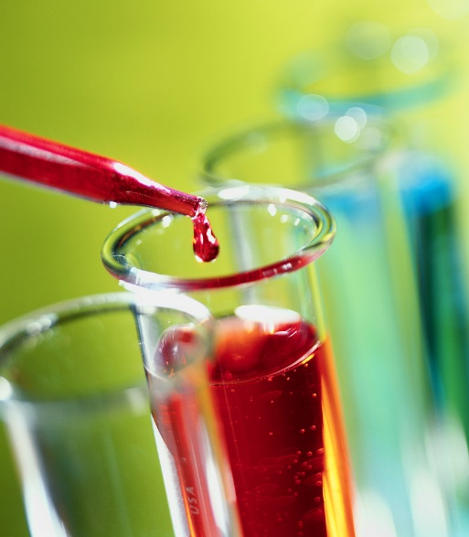
Acids and Bases Can Be Defined in Multiple Ways
Arrhenius definition: Acids form hydronium ions in aqueous solution, while bases form hydroxide ions.
Hydronium = H₃O⁺
Hydroxide = OH⁻
Acid
HCl (g) + H₂O (l) → H₃O⁺ (aq) + Cl⁻ (aq)
Base
NH₃ (g) + H₂O (l) → NH₄⁺ (aq) + OH⁻ (aq)

Slide 26
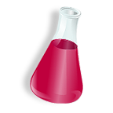
Strong vs. Weak
Strong acids ionize completely in water (produce as much H₃O⁺ as possible^{),} but weak acids do not ionize completely
Strong bases ionize completely in water (produce as much OH⁻_as possible^{),} but weak bases do not ionize completely

Slide 27
Examples that you need to know…
Strong acids
HCl (hydrochloric acid)
HNO₃ (nitric acid)
H₂SO₄ (sulfuric acid)
Weak acids
HCO₃ (carbonic acid)
HC₂H₃O₂ (acetic acid)
HF (hydrofluoric acid)
Strong bases
NaOH
Ca(OH)₂
Weak bases
NH₃

Slide 28
Ionizable Hydrogen
Monoprotic acids: acid that can donate only one hydrogen; ex. HNO₃
Diprotic acids: acid that can donate more than one hydrogen; ex. H₂SO₄
Triprotic acids: acid that can donate more than one hydrogen; ex. H₃PO₄
Polyprotic: acid that can donate more than one hydrogen; ex. H₂SO₄
Amphiprotic: substance can act like an acid or a base ex. H₂O

Slide 29
Another definition:
Bronsted definition: Acids are substances that donate H⁺ (protons), while bases are substances that accept H⁺(protons)
HCl_{(aq)} + NH_{3(aq)} → Cl⁻_{(aq)} + NH₄⁺_{(aq)}
Na₂CO_{3(aq)} + H₂0_{(l)} → NaHCO3_{(aq)} + NaOH_{(aq)}
H₂0_{(l)} + NH_{3 (aq)} → OH⁻_{(aq)} + NH₄⁺_{(aq)}

Slide 30
Conjugate Acid-Base Pairs
Two substances that are related to each other by the donating and accepting of a H⁺ are called conjugate acid – base pairs.
The conjugate base is the particle that remains when an acid has donated a hydrogen ion.
Conjugate acids and bases are always paired with a base or an acid.
HCl + NH₃ → Cl⁻ + NH₄⁺
The ability to remove hydrogen from other molecules determines the strength of a base
Strong acids have weak conjugate bases, and weak acids have strong conjugate bases.
A
B
CB
CA

Slide 31
LEWIS Acid
A Lewis acid is a substance that can accept a pair of electrons to form a covalent bond.
A Lewis base is a substance that can donate a pair of electrons to form a covalent bond.
H⁺ + OH⁻ → H₂O

Slide 32
What is a logarithm
A logarithm is a mathematical operation that determines how many times a certain number, called the base, is multiplied by itself to reach another number.

Slide 33
What are logarithms?
log 1000 = 3
log 0.01 = -2
-log 254 = -2.40
log x = 5 x = 100,000
-log x = -2 x = 100

Slide 34
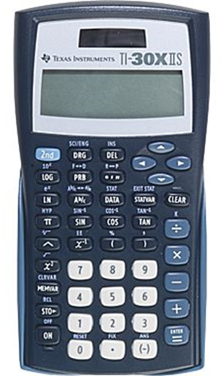

Slide 35
Calculating the pH or pOH
pH = - log [H⁺]
pOH = - log [OH⁻]
(The [ ] means concentration or Molarity)
Example: If [H⁺] = 1.0 X 10⁻¹⁰ M, what is the pH? pH = - log (1 X 10⁻¹⁰)
pH = 10
Example: If [OH⁻] = 1.8 X 10⁻⁵ M ,what is the pOH? pOH = - log 1.8 X 10⁻⁵
pOH = 4.74

Slide 36
pH
the negative logarithm of the hydronium ion concentration in a solution
Important equations to know:
pH = -log [H₃O⁺]
pOH = - log [OH⁻]
[H₃O⁺][OH⁻] = 1.00 x 10⁻¹⁴
pH + pOH = 14

Slide 37
RULES for determining how many digits to write in the answer:
When calculating pH from [H⁺], the number of SIG FIGS in the [H⁺] determines the number of DECIMAL PLACES in the pH
Ex/ [H⁺] = 1.2 x 10⁻⁴ pH = 3.92
2 sig figs 2 decimal places

Slide 38
Try These!
Find the pH of these:
1) [H⁺] = 1.25 x 10⁻³ M
2) A 0.15 M solution of Hydrochloric acid (acids have H⁺ ion)
3) A 3.00 X 10⁻⁷ M solution of Nitric acid

Slide 39
Try These!
Find the pOH of these:
1) [OH⁻] = 2.15 x 10⁻³
2) A 0.35 M solution of NaOH (bases have OH⁻ ion)
3) A 3.00 X 10⁻⁷ M solution of potassium hydroxide

Slide 40
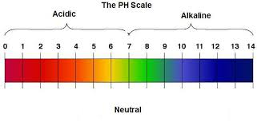
Calculating the pOH or pH when you KNow the other One
Since acids and bases are opposites, pH and pOH are opposites!
If pH = 1, then pOH is at the same point on the opposite side of the scale
pOH = 13
Since pH and pOH are on opposite ends,
pH + pOH = 14

Slide 41
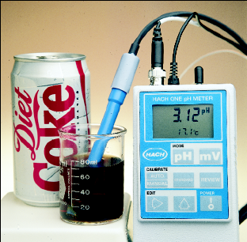
_{p}H and _{p}OH calculations Solving for [H⁺] and [OH⁻]
If the pH of Coke is 3.12, [H⁺] = ???
Because pH = - log [H⁺] then
- pH = log [H⁺]
10^{-pH} = [H⁺] or
[H⁺] = antilog^{-pH}
[H⁺] = antilog^{-3.12} = 7.6 x 10⁻⁴ M

Slide 42
_{p}OH calculations – Solving for [OH⁻]
If the pOH of soap is 8.9, what is the [OH⁻]?
10^{-pOH} = [OH⁻] or
[OH⁻] = antilog^{-pOH}
[OH⁻] = antilog^{-8.9} =
(show sci / eng button)

Slide 44
RULES for determining how many digits to write in the answer:
When calculating [H⁺] from pH, the number of DECIMAL PLACES in the pH determines the number of SIG FIGS in the [H⁺]
Ex/ pH = 3.85 [H⁺] = 1.2 x 10⁻⁴
2 decimal places 2 sig figs

Slide 45
[H⁺], [OH⁻] anD k_{w}
We can also use K_{w} (water constant)
K_{w} = 1 x 10⁻¹⁴
K_{w} = [H⁺] [OH⁻] , so
[H⁺] [OH⁻] = 1 x 10⁻¹⁴
What is the [H⁺] of a solution that
has an [OH⁻] = 4.2 x 10⁻⁵ ?

Slide 46
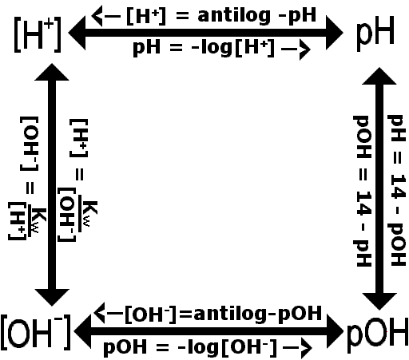

Slide 47
What is the pH of a 1.7 x 10⁻⁵ M solution of HCl?
What is the pOH of a .032M solution of NaOH?
A solution has a pH of 6.4. What is the [H⁺]?
What is the pOH of a solution with a pH of 4.5?

Slide 48
What is the [H⁺] of a 1.6 x 10⁻⁹ M
solution of NaOH?
What is the [H⁺], [OH⁻], and pOH
of a solution with pH = 3.67?
Is this an acid, base, or neutral?

Slide 49
Calculating [H⁺], pH, [OH⁻], and pOH

Slide 50
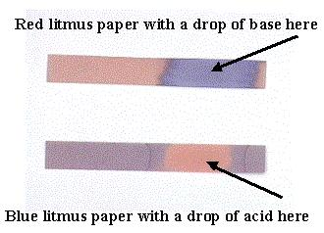
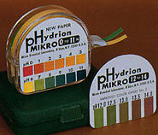
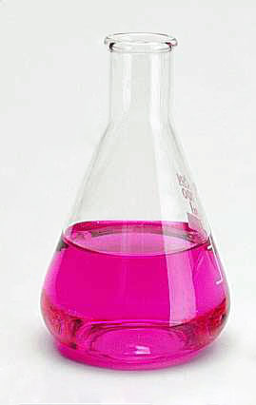
pH testing
There are several ways to test pH
Blue litmus paper (red = acid)
Red litmus paper (blue = basic)
pH paper (multi-colored)
pH meter (7 is neutral, <7 acid, >7 base)
Universal indicator (multi-colored)
Indicators like phenolphthalein
Natural indicators like red cabbage, radishes

Slide 51
ACID-BASE REACTIONS Titrations
HCl _{(aq)} + NaOH _{(aq)} → NaCl _{(aq)} + H₂O _{(l)}
acid base
We can carry out this neutralization reaction using TITRATION.
This will allow us to determine the unknown concentration of an acid or base ([H⁺] or [OH⁻])

Slide 52
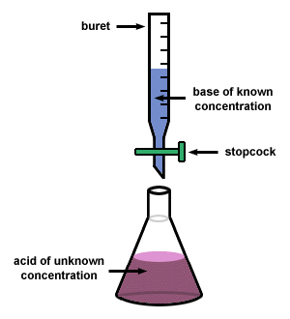
ACID-BASE REACTIONS Titrations
At the end of a titration reaction
Moles of acid = moles of base

Slide 53
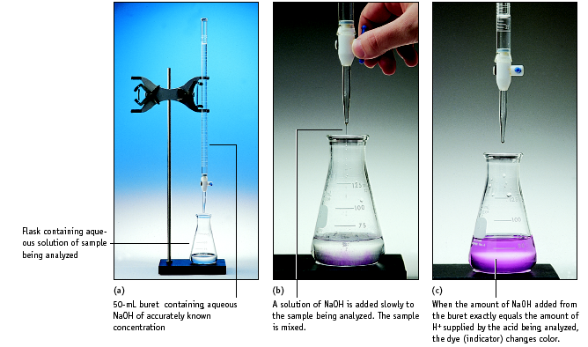
Titration is used to determine the
Concentration of OH⁻ (or H⁺) ion in
the solution being analyzed

Slide 54
Titration Calculations
For titrations using HCl and NaOH, we can simply use the dilution formula to do our calculations (because there is one H⁺ for every one OH⁻)
M₁V₁ = M₂V₂

Slide 55
Titration Calculations
Example: Determine the volume of .0100M NaOH needed to titrate 20.0mL of 0.400M HCl?

Slide 56
Titration Calculations
Example: What is the concentration of HCl if 34.5 mL of .0500M NaOH is required to titrate 50.0mL of the HCl solution?

